Slide 1
Provision
Revelation 7

Slide 2
God’s Work Through History
Only 1 Voice Can Explain Life on Earth
Isaiah 41:21-24 (NLT) “Present the case for your idols,” says the LORD. “Let them show what they can do,” says the King of Israel. “
Let them try to tell us what happened long ago so that we may consider the evidence.
Or let them tell us what the future holds, so we can know what’s going to happen. Yes, tell us what will occur in the days ahead. Then we will know you are gods.
In fact, do anything—good or bad! Do something that will amaze and frighten us. But no! You are less than nothing and can do nothing at all. Those who choose you pollute themselves.
Notes:
1Voice = **“King” = God; “Evidence”→Faith ~Blind =3 Rsns:
“Long Ago” → Creation & B4 → Course of Hist: ??Underst?? Marx??
“Future Holds” =ONLY G. Knows→Controls=BIG PROOF
“DO ANYTH!!” =Prob. w/ “My Persn’l god” 2Day
“POLLUTE”=Big Prob! =Poisoned on Life=Decay

Slide 3
God’s Work Through History
Israel
The “Gentile Age”
“Jacob’s Trouble”
Romans 9:4-5 (NASB) [The] Israelites, to whom belongs the adoption as sons, and the glory and the pledges [of God] and the giving of the Law and the temple service and the promises…from whom is the Messiah…who is over all…
Notes:
G=Wrks IN HIST → ** 3 Periods of “Rev”:
#1) **Israel=O.T. → 2000 Yrs!! (Abraham}
** Ro.9=Proph/Pics/Promises → Messiah=GOD!!

Slide 4
God’s Work Through History
Israel
“Gentile Age”
“Jacob’s Trouble”
Romans 11:25-26 (NLT) …Some of the people of Israel have hard hearts…
but this will last only until the full number of Gentiles comes to Christ. And so all Israel will be saved.
Isaiah 49:6 (NASB) "It is too small a thing that You should be My Servant To raise up the tribes of Jacob…I will also make You a light of the nations So that My salvation may reach to the end of the earth."
“Replacement Theology”
Notes:
JC= Introd. “Gentile Age” → ** Is.49 =Ch.Age
“?? Israel??” → **Ro.11 Hrd.Hrts → **Replacem.Theol.!?
=WRONG: **v.26 Is=Changed Hrts → ALL SAVED

Slide 5
God’s Work Through History
Israel
The “Gentile Age”
Jacob’s Trouble
Isaiah 49:12-14 (NLT) My people will return from far away, from lands to the north and west… Sing for joy, O heavens! Rejoice, O earth! Burst into song, O mountains! For the LORD has comforted his people and will have compassion on them in their suffering.
Yet Jerusalem says, “The LORD has deserted us; the Lord has forgotten us.”
Notes:
“All Saved” ~Smooth → “J’s TROUBLE!”
**Is.49=Cool! Amaz! Aftr 2k Yrs! ??Possibl??
BUT: **v.14: ??B Angry?? → “G..Deserted” ~Really! Hello??
YET=Israel 2Day → Most Atheistic → G=AMAZ!!
??GUESS?? ~Make Sense → LUK!! 2DAY!!

Slide 6
God’s Work Through History
Israel
The “Gentile Age”
Jacob’s Trouble
Isaiah 43:5-8 (NASB) "I will bring your offspring from the east, And gather you from the west. I will say to the north, 'Give them up!' And to the south, 'Do not hold them back.' Bring My sons from afar And My daughters from the ends of the earth…
“Bring out the people who are blind, even though they have eyes, And the deaf, even though they have ears.”
FULFILLED 1948
FULFILLED today
Notes:
Is.43 = ~Jst 1x → Repeats! → “East/W/N/S”=** ’48 ONLY
**BUT: v.8 “Blind..” = Hard Hrts @This Time→ JC Quotes
G=AWESOME! Amaz! =** Clear Pic. Israel 2Dy

Slide 7
God’s Work Through History
Israel
“Gentile Age”
Jacob’s Trouble
7 Year Tribulation
Israel Finds Her Messiah
Israel: the Center of Everything
Revelation 7
Notes:
“J’s Trbl” = Recurr. O.T. Proph → ** “Tribulat”=Global
** Messiah: Turns 2 JC/Savior ← Culmin. OT Proph
** @Center: 1) Political Conflict 2) Spiritual Reviv.
** =Rev.7 = Pivotal Ch → Now Israel=Centr Stage

Slide 8
Revelation 7
Revelation 4:2-4 (NASB) …standing in heavenI saw twenty-four elders sitting, clothed in white garments, and golden crowns on their heads.
Revelation 4:10 (NASB) the twenty-four elders fall down before Him who sits on the throne, and worship Him who lives forever and ever, and cast their crowns before the throne, saying, “Worthy are You, our Lord and our God, to receive glory and honor and power…”
AFTER the “Rapture”
Notes:
Rev.4=Aftr 3 Ch’s re: CHRCH → **24 Eld=??
→12 Tribes/Disciples=Obvious, ~Angels
“Crowns” = Rewards → Selfish? NO → **v10f
Hvn & G’s Throne = Love/Share,
~SELF/Competit=Grt.Trib…

Slide 9
Revelation 7
Revelation 5:1 (NASB) I saw in the right hand of Him who sat on the throne a book written inside and on the back, sealed up with seven seals…
Revelation 6:1 (NASB) Then I saw when the Lamb broke one of the seven seals, and I heard one of the four living creatures saying as with a voice of thunder, "Come."
Revelation 6:12-14 (NASB) I looked when He broke the sixth seal, and there was a great earthquake; and the sun became black as sackcloth made of hair, and the whole moon became like blood; and the stars of the sky fell to the earth, as a fig tree casts its unripe figs when shaken by a great wind. The sky was split apart like a scroll when it is rolled up, and every mountain and island were moved out of their places.
AFTER the “Rapture”
DURING the “Tribulation”
Global Conquest
War
Famine
Death
Notes:
Rev.5 = BOOK = WOG→ ?Worthy? → JC/Lamb
**Rev.6 = SEALS → ** 4 Horse Men = TROUBLE!!
Lit. BILLIONS Die → ** v.12f = Real 2Day

Slide 10
Revelation 7
Revelation 7:1-3 (NASB) After this I saw four angels standing at the four corners of the earth, holding back the four winds of the earth, so that no wind would blow on the earth or on the sea or on any tree. And I saw another angel ascending from the rising of the sun, having the seal of the living God; and he cried out with a loud voice to the four angels to whom it was granted to harm the earth and the sea, saying, “Do not harm the earth or the sea or the trees until we have sealed the bond-servants of our God on their foreheads.”
AFTER the “Rapture”
DURING the “Tribulation”
God Still Provides
Notes:
=During WORSE Time on Earth, G=Plan 2 SAVE
** 7:1ff “4 Corners” = GLOBAL Unrest
“4 Winds” =Destruction → “Perfect Storm”
“Do not harm…” = REWIND, b4 Billions Die
“Seal…foreheads” = H.S. → “Mind…JC”
= U & I → HS&Mind =PRIVIL! PWR!! 2Dy!!

Slide 11
Revelation 7
Revelation 7:4-8 (NASB) And I heard the number of those who were sealed, 144,000 sealed from every tribe of the sons of Israel
AFTER the “Rapture”
DURING the “Tribulation”
God Still Provides
Through Israel
Confusion!!
Jehovah’s Witnesses
Gentile-Jews (!?!?)
Mormons
Replacement Theology
Notes:
v.7=Led 2 → ** Confusion ** JWs ** Morms ** Misc. “Lost Tribes”
** Frm “Repl.Th” → ??Blame?? ~Make Sense!! →Figuratv?
AP: “~Take Literally” =SRC of GREATEST Evils →Anti-Semitism

Slide 12
Revelation 7
Revelation 7:4-8 (NASB) And I heard the number of those who were sealed, 144,000 sealed from every tribe of the sons of Israel
from the tribe of Judah, 12,000 were sealed, from the tribe of Reuben 12,000, from the tribe of Gad 12,000, from the tribe of Asher 12,000, from the tribe of Naphtali 12,000, from the tribe of Manasseh 12,000, from the tribe of Simeon 12,000, from the tribe of Levi 12,000, from the tribe of Issachar 12,000, from the tribe of Zebulun 12,000, from the tribe of Joseph 12,000, from the tribe of Benjamin, 12,000 were sealed.
AFTER the “Rapture”
DURING the “Tribulation”
God Still Provides
Through Israel
Notes:
V5ff = LITERAL: “12 x 12” → G’s “Movement”
G.Knows Tribes → ? 12k ? → G’s Work=G’s Organiz.
AP: Like BOC = “I…build MY Church” →~Human Org=MESS!!

Slide 13
Revelation 7
Revelation 7:9-10 (NASB) After these things I looked, and behold, a great multitude which no one could count, from every nation and all tribes and peoples and tongues, standing before the throne and before the Lamb, clothed in white robes, and palm branches were in their hands; and they cry out with a loud voice, saying, "Salvation to our God who sits on the throne, and to the Lamb."
AFTER the “Rapture”
DURING the “Tribulation”
God Still Provides
Through Israel
Notes:
“Palm…” = REAL Palm Sunday= “Hosannah”= “G’s Salv”
Apparently the RESULTS=BIG bc…

Slide 14
Revelation 7
Revelation 7:13-14 (NASB) Then one of the elders answered, saying to me, "These who are clothed in the white robes, who are they, and where have they come from?" I said to him, "My lord, you know." And he said to me, "These are the ones who come out of the great tribulation, and they have washed their robes and made them white in the blood of the Lamb.
Revelation 6:9-11 (NASB) …I saw underneath the altar the souls of those who had been slain because of the word of God, and because of the testimony which they had maintained; and they cried out with a loud voice, saying, "How long, O Lord, holy and true…?”
and they were told that they should rest for a little while longer, until the number of their fellow servants and their brethren who were to be killed even as they had been, would be completed also.
AFTER the “Rapture”
DURING the “Tribulation”
God Still Provides
Through Israel
Notes:
=Souls Saved During Trib= **Answ.6:9 Question
G=Grows His Church via MARTYRS → ~HIJACKED Word!!
Martyr=Begin. w/JC → AP: U & I = Price 2 SHARE JC
“Pick..Cross..Follow” = LABOR of LOVE

Slide 15
Revelation 7
Revelation 7:15-17 (NASB) For this reason, they are before the throne of God; and they serve Him day and night in His temple; and He who sits on the throne will spread His tabernacle over them.
They will hunger no longer, nor thirst anymore; nor will the sun beat down on them, nor any heat;
for the Lamb in the center of the throne will be their shepherd, and will guide them to springs of the water of life; and God will wipe every tear from their eyes."
Isaiah 2:4 (NASB) And He will judge between the nations, And will render decisions for many peoples; And they will hammer their swords into plowshares and their spears into pruning hooks. Nation will not lift up sword against nation, And never again will they learn war.
AFTER the “Rapture”
DURING the “Tribulation”
God Still Provides
Through Israel
Notes:
V15-17=G. Provides=Fulfill Dream of Mankind
Xians ~Doomsday: GRT Optimists/Future
Jst ~Blv. Manmade Solut=Wrk: Hist. PROOVES
**Is.2:4 = U.N. =WAR ROOM, ~Fulfill Promises
JC’s Solut=WORKs: Cross→2Day … ~COMPULSION

Slide 16
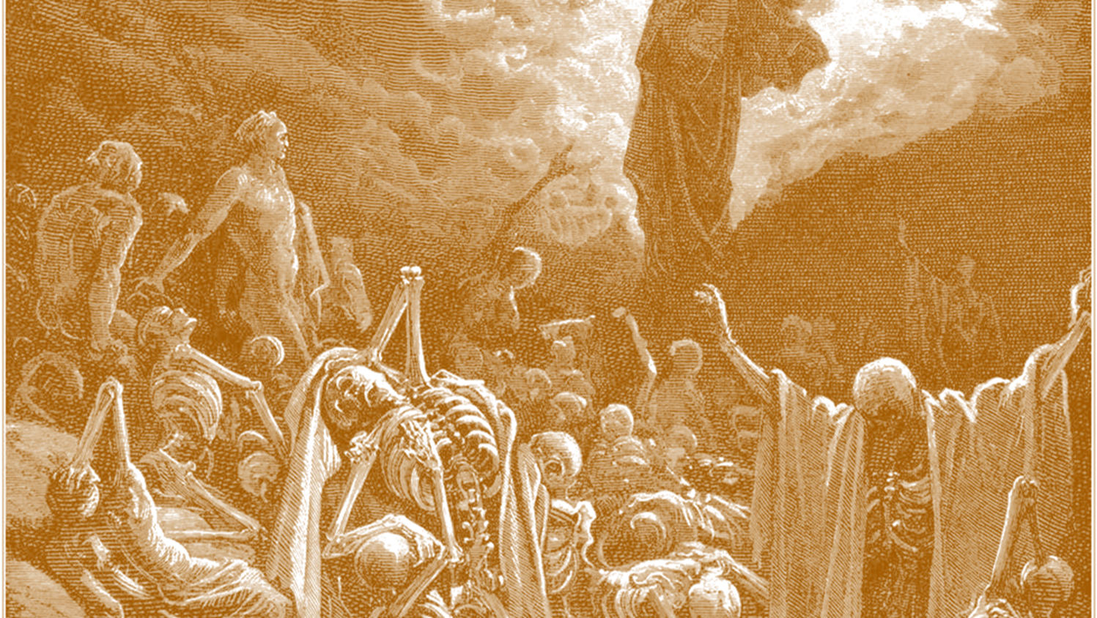
Ezekiel 37:1-3
¹ The LORD took hold of me, and I was carried away by the Spirit of the LORD to a valley filled with bones. ² He led me all around among the bones that covered the valley floor. They were scattered everywhere across the ground and were completely dried out.
Then he asked me, “Son of man, can these bones become living people again?” “O Sovereign LORD,” I replied, “you alone know the answer to that.”
Notes:
Really Creepy Passage…

Slide 17
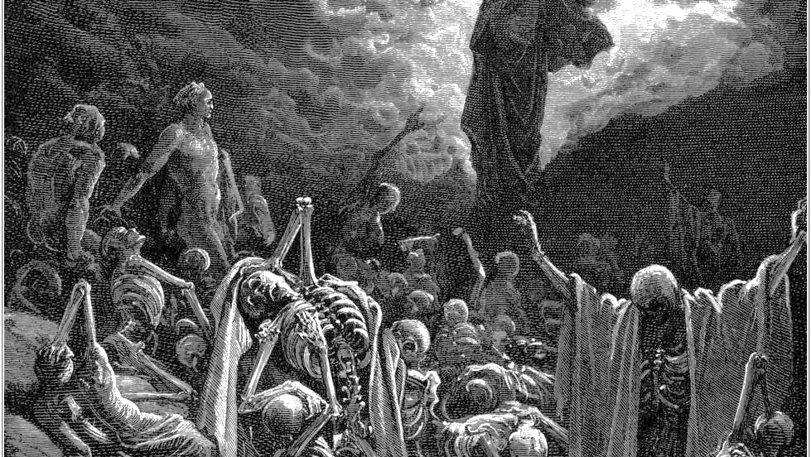
Ezekiel 37:4-6
4 Then he said to me, “Speak a prophetic message to these bones and say, ‘Dry bones, listen to the word of the LORD!
5 This is what the Sovereign LORD says: Look! I am going to put breath into you and make you live again!
6 I will put flesh and muscles on you and cover you with skin. I will put breath into you, and you will come to life. Then you will know that I am the Creator God.’”

Slide 18
Ezekiel 37:7-8
So I prophesied as I was commanded. And as I was prophesying, there was a noise, a rattling sound, and the bones came together, bone to bone.
I looked, and tendons and flesh appeared on them and skin covered them, but there was no breath in them.
Israel?

Slide 19
Ezekiel 37:11-12
Then he said to me, “Son of man, these bones represent the people of Israel. They are saying, ‘We have become old, dry bones—all hope is gone. Our nation is finished.’
Therefore, prophesy to them and say, ‘This is what the Sovereign LORD says: O my people, I will open your graves of exile and cause you to rise again. Then I will bring you back to the land of Israel.’

Slide 20
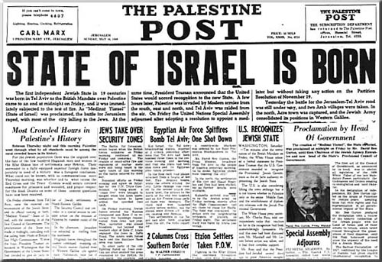
Ezekiel 37:21
Unstoppable
“I will gather the people of Israel from among the nations. I will bring them home to their own land from the places where they have been scattered.

Slide 21
What’s The Point?
Our World Is In Tremendous Spiritual Upheaval
2 Timothy 4:3-4 (NASB) For the time will come when they will not endure sound doctrine; but wanting to have their ears tickled, they will accumulate for themselves teachers in accordance to their own desires, and will turn away their ears from the truth and will turn aside to myths.
Matthew 24:14 (NASB) "This gospel of the kingdom shall be preached in the whole world as a testimony to all the nations, and then the end will come.
Romans 11:25-26 (NLT) …Some of the people of Israel have hard hearts…
but this will last only until the full number of Gentiles comes to Christ. And so all Israel will be saved.
Notes:
**CHAOS = **2Tim.4 =USA → 20+ Million Drifters
@Same Time: **Mt.24:14 → India/China/Africa=MILLIONS
** Ro.11 EVEN ISRAEL == EXCITING! →Join the PARTY!

Slide 22
What’s The Point?
Our World Is In Tremendous Spiritual Upheaval
The Tribulation Will Occur
Notes:
** Trib=Certain as ISRAEL 2DAY → Is It There??? YES!!!

Slide 23
What’s The Point?
Our World Is In Tremendous Spiritual Upheaval
The Tribulation Will Occur
God Will Still Provide Salvation
Isaiah 41:21-24 “Present the case for your idols,” says the LORD. “Let them show what they can do,” says the King of Israel. “
Let them try to tell us what happened long ago so that we may consider the evidence.
Or let them tell us what the future holds…
John 5:24 (NASB) "Truly, truly, I say to you, he who hears My word, and believes Him who sent Me, has eternal life, and does not come into judgment, but has passed out of death into life.
Acts 4:12 (NASB) "And there is salvation in no one else; for there is no other name under heaven that has been given among men by which we must be saved."
Notes:
G=Provides Salvat=Msg. 2DAY →
~Fake **Is.41 → REAL Salvat. **Acts 4:12=Observat, ~Claim
** Jn.5:24 → TODAY/TONIGHT

